Slide 1
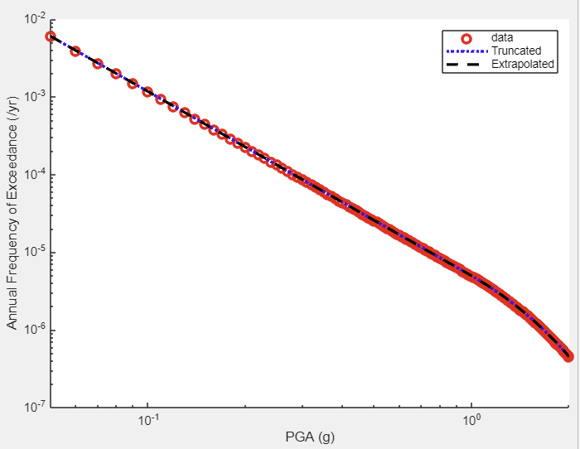
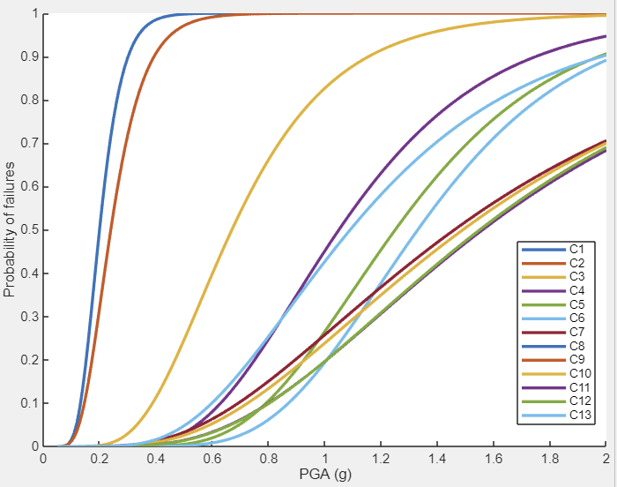
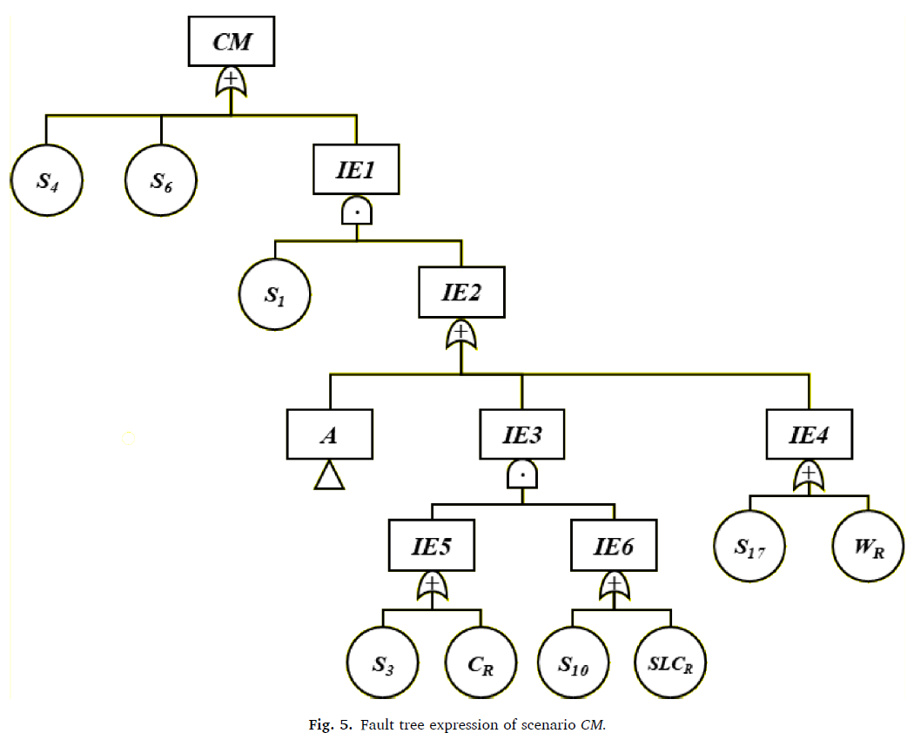
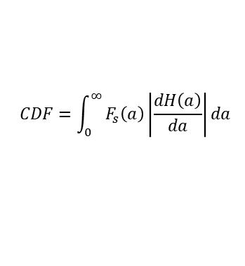
EHRA Structure
EHRA Program Modules
Input
Hazard Input
Fragility Input
Systems Analysis Model Input
$$CDF=\int_{0}^{∞}{F_{s}\left(a\right)\left|\frac{dH\left(a\right)}{da}\right|da}$$
Risk
Quantification
Output
Risk Assessment Results

Slide 2
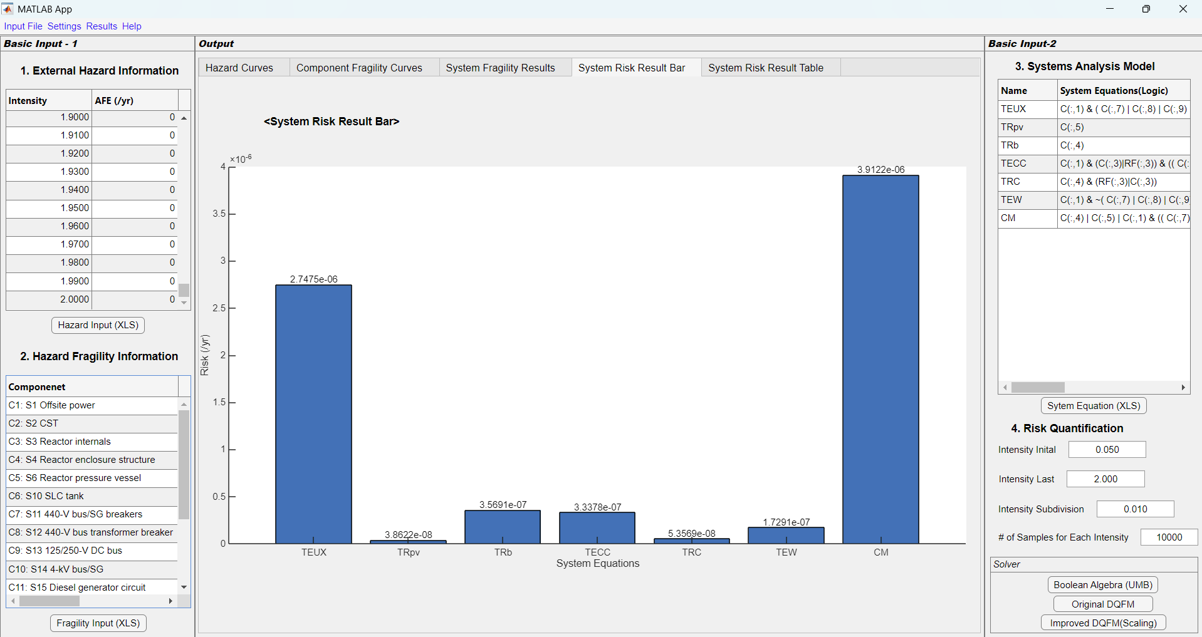
Matlab GUI Application Configuration
(a)
(c)
(b)
(e)
(d)

Slide 3
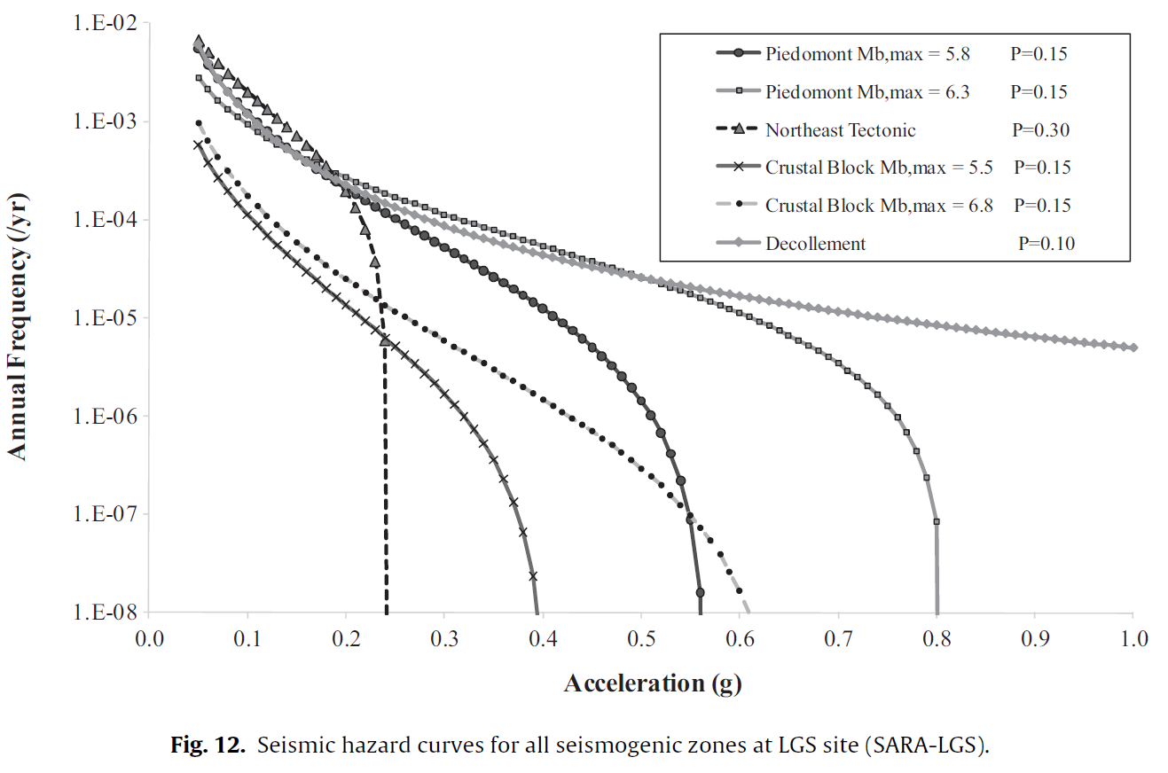
Example: LGS Nuclear Power Plant
(Seismic) Hazard Curves
Ellingwood, B. (1990). Validation studies of seismic PRAs. Nuclear Engineering and Design, 123(2-3), 189-196.
Kim, J. H., Choi, I. K., & Park, J. H. (2011). Uncertainty analysis of system fragility for seismic safety evaluation of NPP. Nuclear Engineering and Design, 241(7), 2570-2579.
Kwag, S., Choi, E., Eem, S., Ha, J. G., & Hahm, D. (2021). Toward improvement of sampling-based seismic probabilistic safety assessment method for nuclear facilities using composite distribution and adaptive discretization. Reliability Engineering & System Safety, 215, 107809.

Slide 4
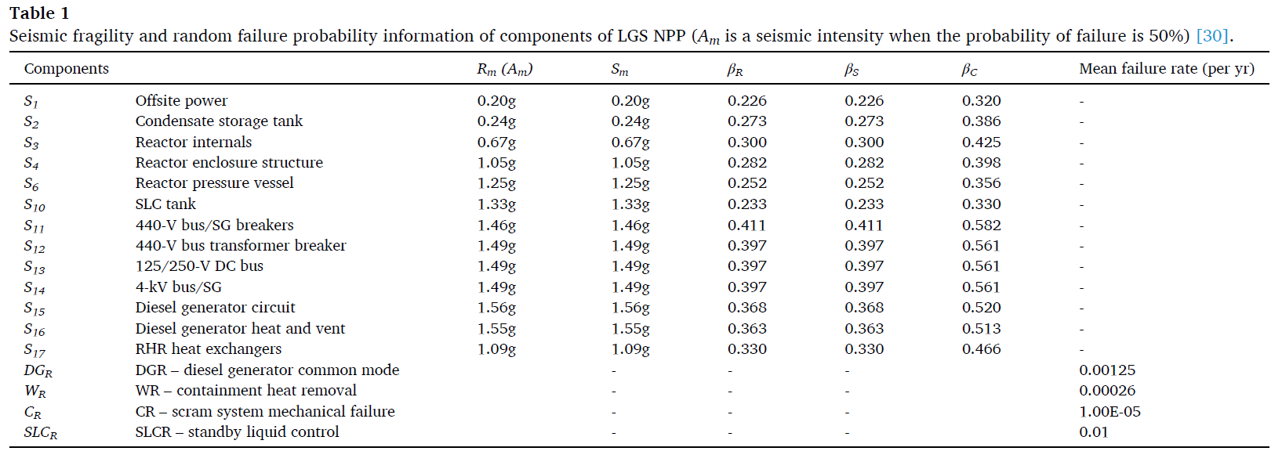
Example: LGS Nuclear Power Plant
(Seismic) Fragility Curves
Ellingwood, B. (1990). Validation studies of seismic PRAs. Nuclear Engineering and Design, 123(2-3), 189-196.
Kim, J. H., Choi, I. K., & Park, J. H. (2011). Uncertainty analysis of system fragility for seismic safety evaluation of NPP. Nuclear Engineering and Design, 241(7), 2570-2579.
Kwag, S., Choi, E., Eem, S., Ha, J. G., & Hahm, D. (2021). Toward improvement of sampling-based seismic probabilistic safety assessment method for nuclear facilities using composite distribution and adaptive discretization. Reliability Engineering & System Safety, 215, 107809.

Slide 5
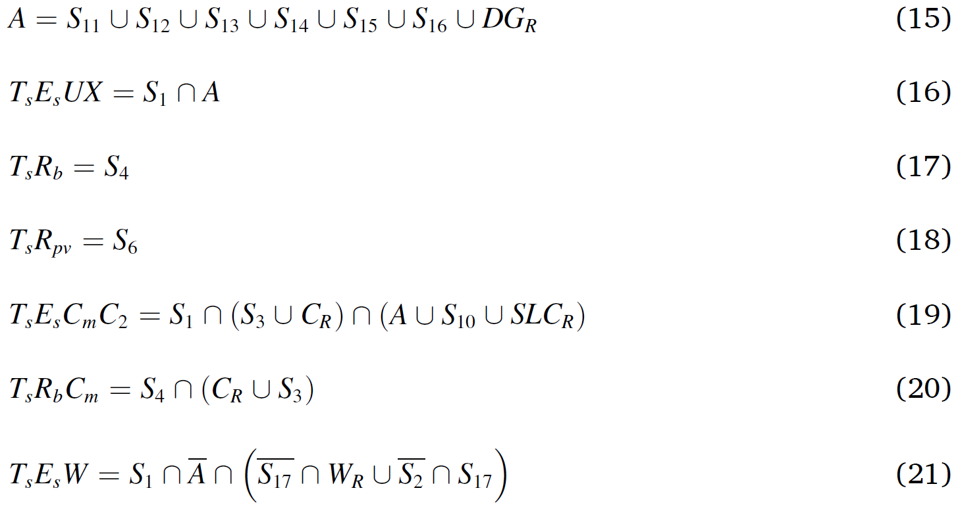
Example: LGS Nuclear Power Plant
Systems Analysis Models
Ellingwood, B. (1990). Validation studies of seismic PRAs. Nuclear Engineering and Design, 123(2-3), 189-196.
Kim, J. H., Choi, I. K., & Park, J. H. (2011). Uncertainty analysis of system fragility for seismic safety evaluation of NPP. Nuclear Engineering and Design, 241(7), 2570-2579.
Kwag, S., Choi, E., Eem, S., Ha, J. G., & Hahm, D. (2021). Toward improvement of sampling-based seismic probabilistic safety assessment method for nuclear facilities using composite distribution and adaptive discretization. Reliability Engineering & System Safety, 215, 107809.

Slide 6
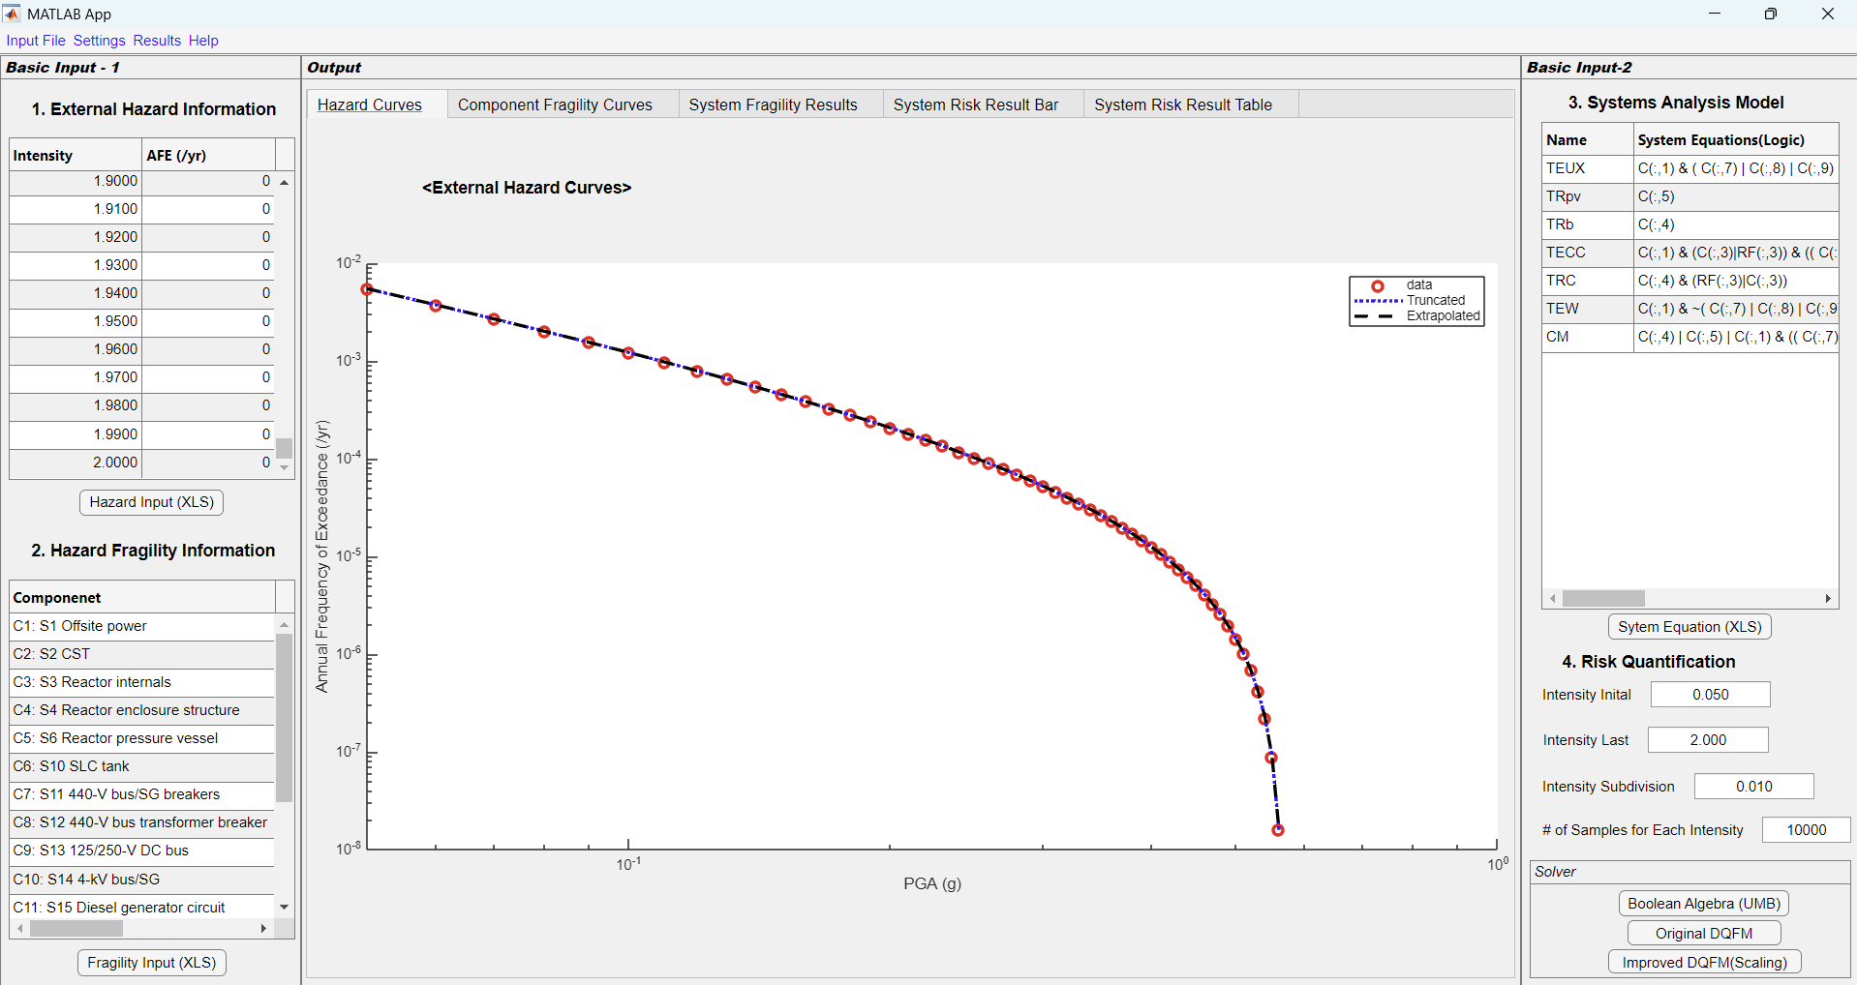
Example: LGS Nuclear Power Plant
Seismic Harzard Curve Input & Confirmation
Seismic Hazard Curve for Piedomont Mb,max=5.8

Slide 7
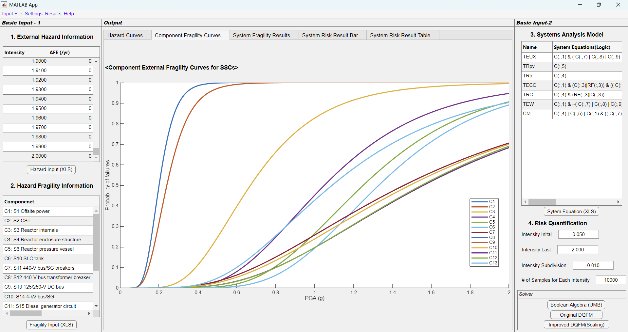
Example: LGS Nuclear Power Plant
Component Seismic Fragility Curve Input & Confirmation
Component Seismic Fragility Curves for LGS NPP SSCs

Slide 8
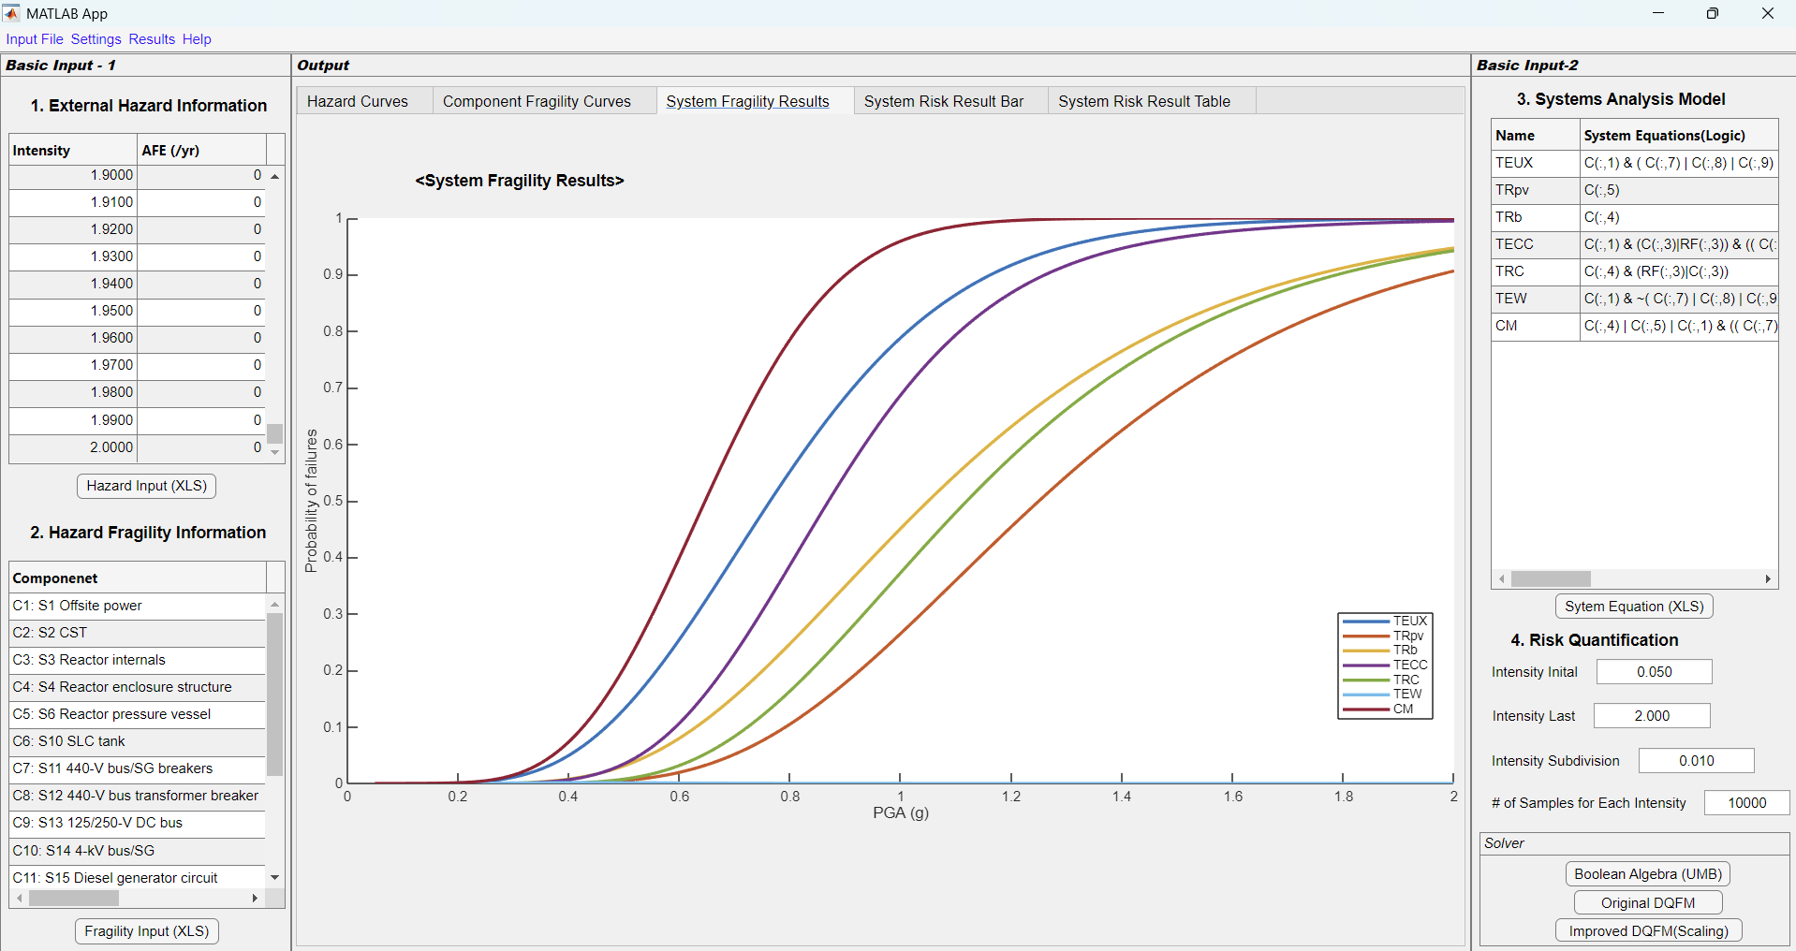
Example: LGS Nuclear Power Plant
Systems Analysis Model Input & System Fragility Results
Two Types of Systems Analysis Models:
(1) Logic Equation, and (2) UMB-type Equation

Slide 9

Example: LGS Nuclear Power Plant
Risk Quantification Input & System Risk Results
Risk Quantification Bar Result using Three Different Solvers

Slide 10
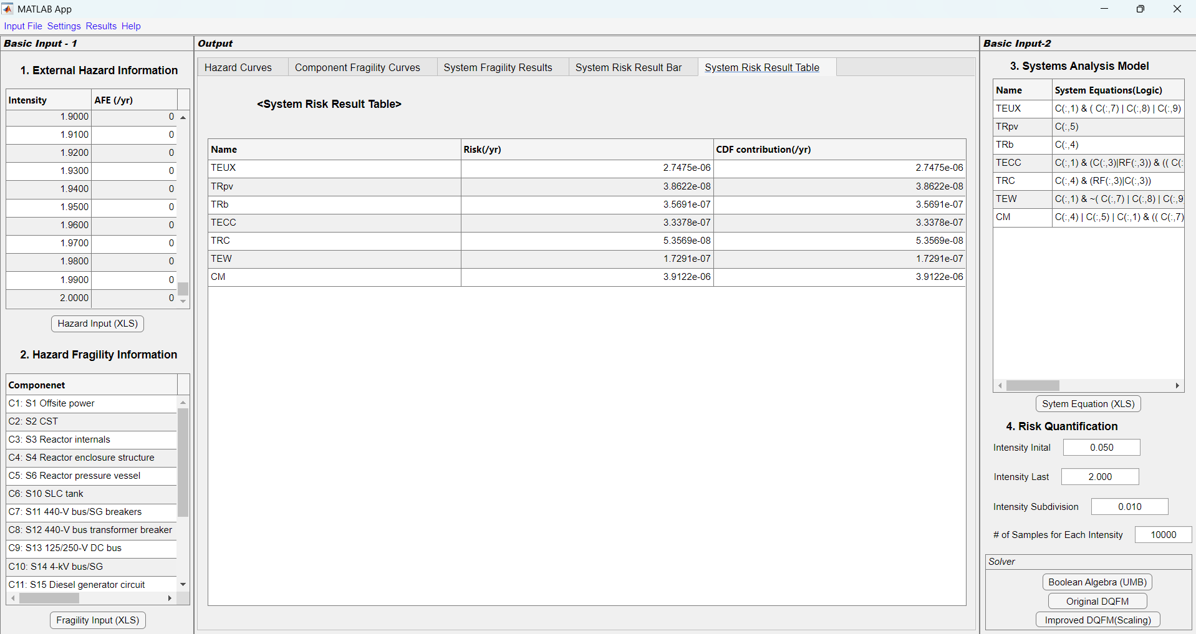
Example: LGS Nuclear Power Plant
Risk Quantification Input & System Risk Results
Risk Quantification Table Result using Three Different Solvers

Slide 11
Appendix. File Type and Import for Example Case

Slide 12

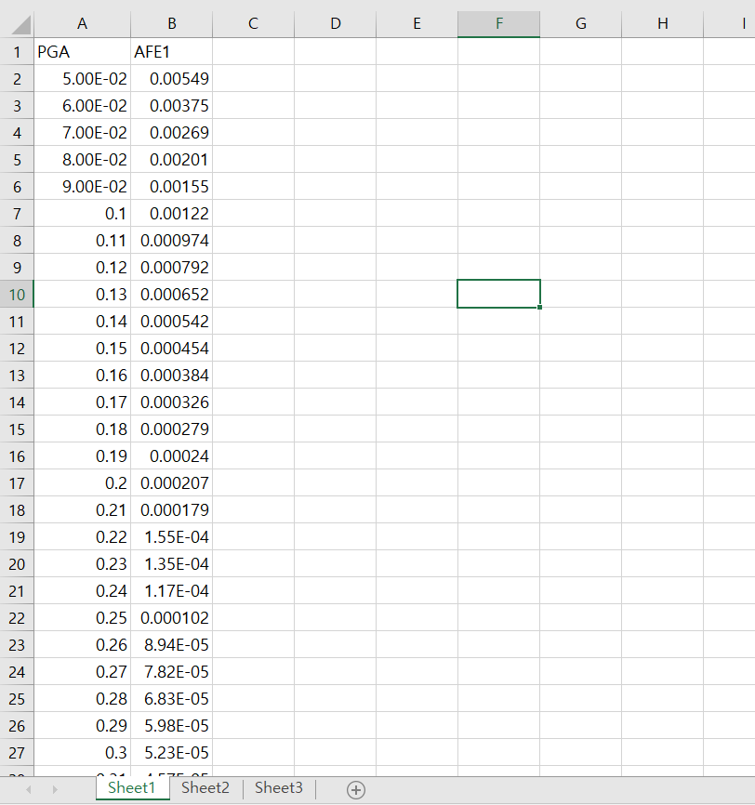
Appendix. File Type and Import
Seismic Harzard Curve Input
Input_Data_LGS1.xlsx
Button Click and Import Sheet1 of the EXCEL file.

Slide 13
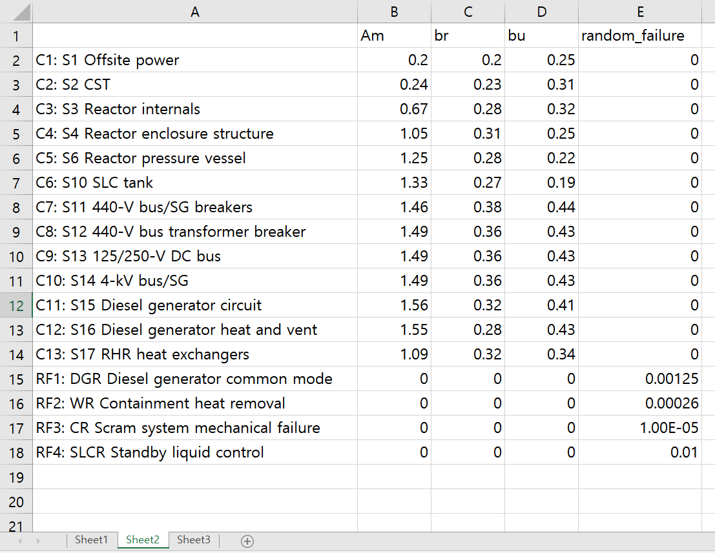
Appendix. File Type and Import
Seismic Fragility Curve Input
Input_Data_LGS1.xlsx
Button Click and Import Sheet2 of the EXCEL file.

Slide 14
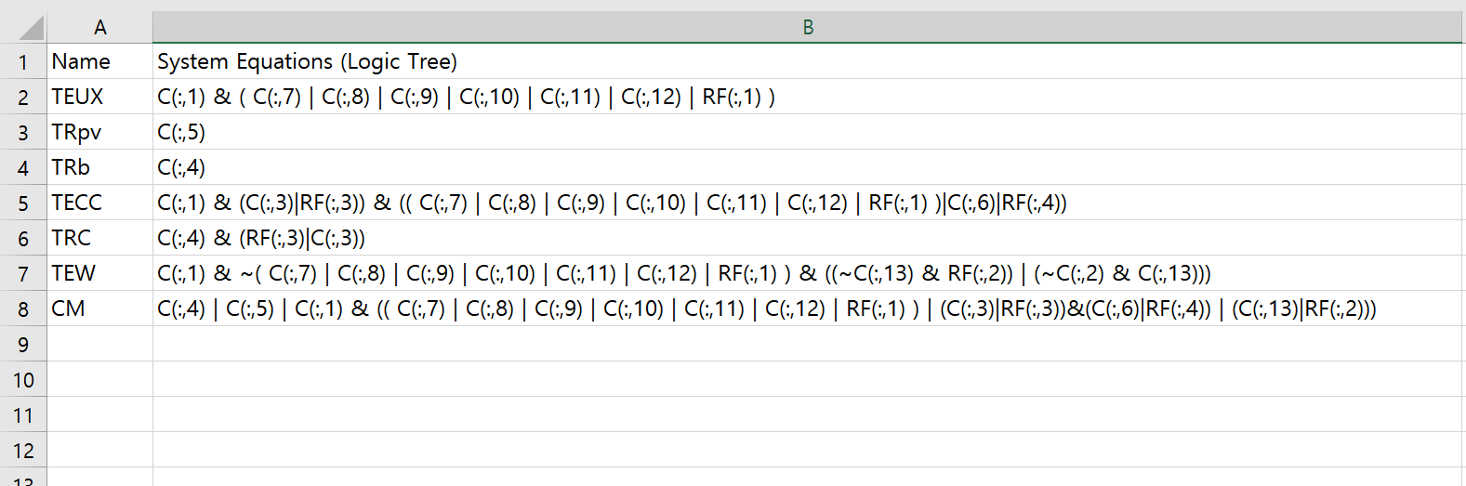
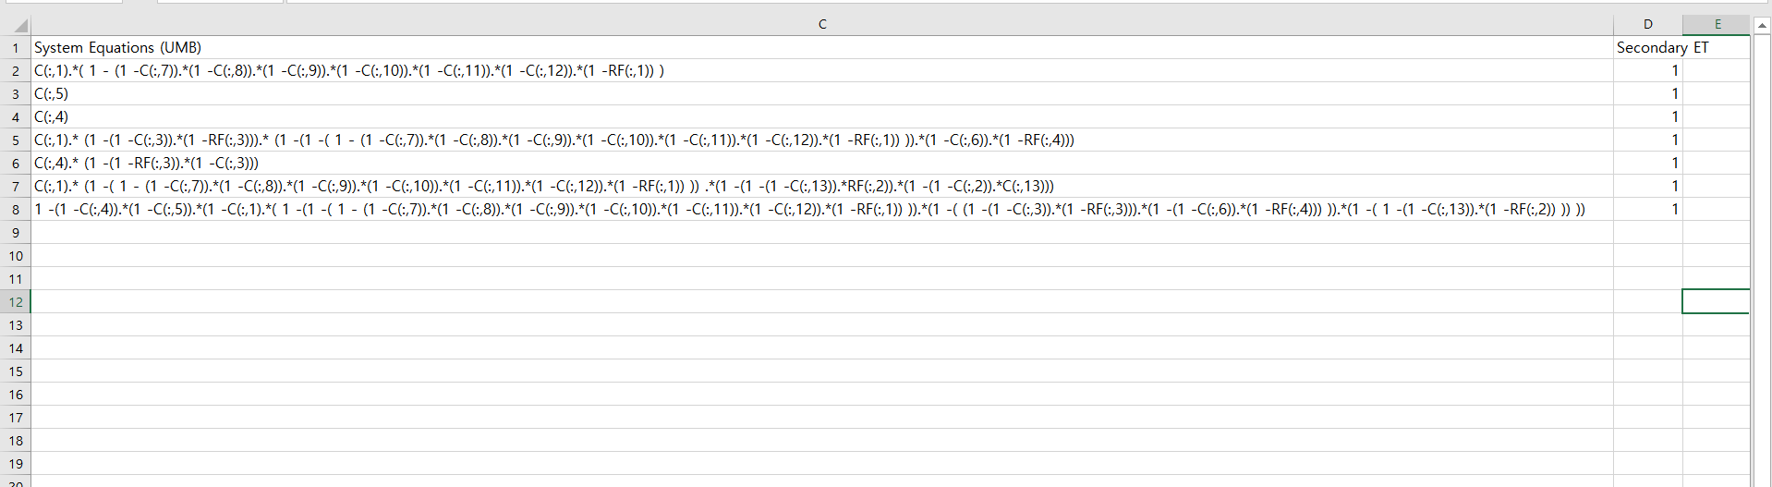
Appendix. File Type and Import
Systems Analysis Model Input
Input_Data_LGS1.xlsx
“Event Tree and Fault Tree-type” Model -> “Logical Expression”
Button Click and Import Sheet3 of the EXCEL file.
⁞
“Event Tree and Fault Tree-type” Model ->
“Uni-Modal Bound(UMB) Approach-type Mathematical Expression”

